Slide 1
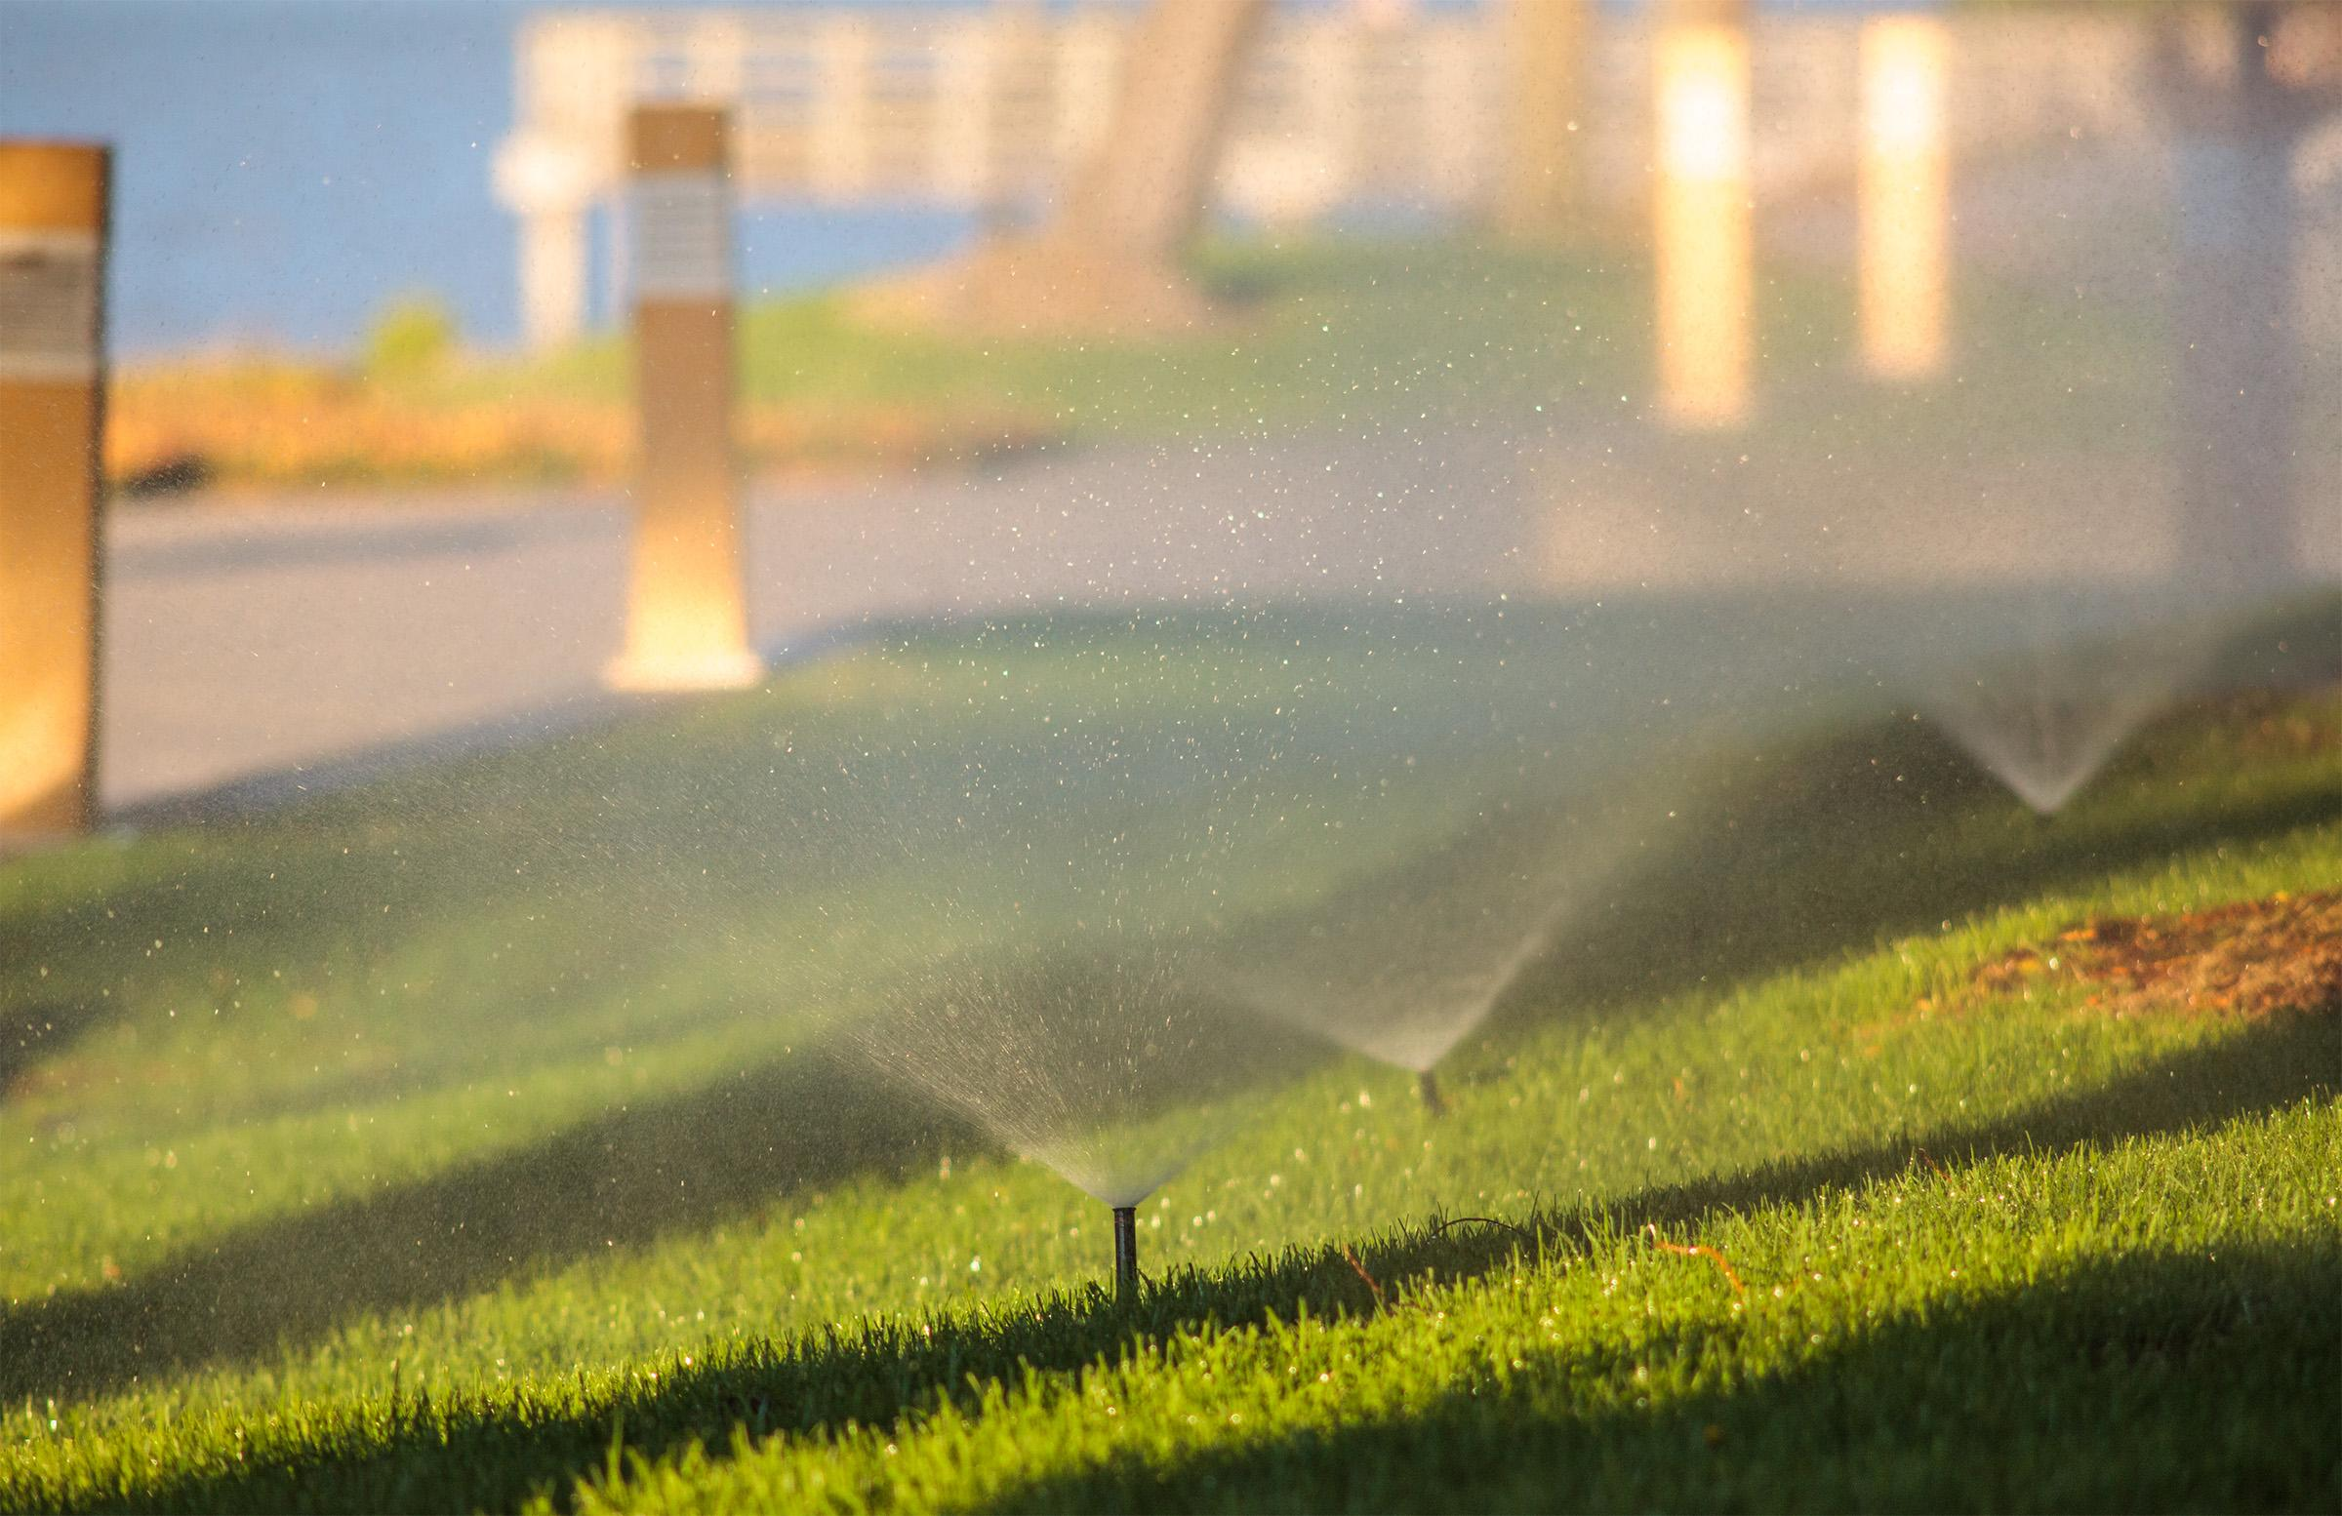
GREYWATER AND BLACKWATER
We will analyse the impacts of greywater and blackwater recycling.
Notes:
Insert cover image and use transparency settings to fade image.

Slide 2
Do not delete this slide.
This slide is designed so that you can copy the prompt box you need and insert it into your slides.
This slide is hidden and will not be included when presenting your lesson.
TRACK WITH ME
VOCABULARY
1 -
HINT
Students, remember….
CHECK FOR UNDERSTANDING
READ WITH ME
TEACHER CUE
MAKE THE CONNECTION
Students, you already know….
EXTENSION
GESTURE WITH ME

Slide 3
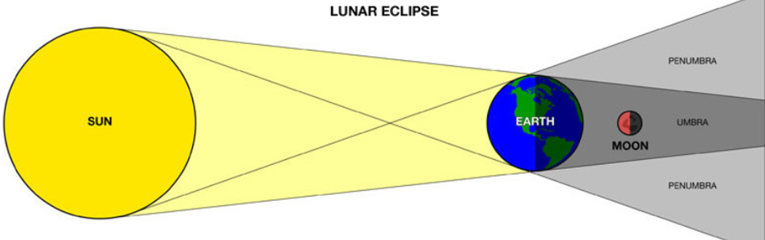
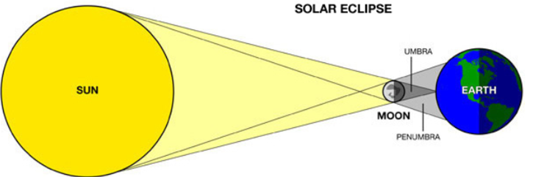
Fill in the table to identify the solar and lunar eclipse.
Identify them as total or partial eclipses .
Name of eclipse | Order | When it occurs | What we look at | Letter | Total or partial eclipse
Solar eclipse | S M E | Day time | Sun
Lunar eclipse | S E M | Night time | Moon
B
A
X

Slide 4
Repeat the opposite word/phrase.
RENEWABLE RESOURCE
IT WILL NOT RUN OUT

Slide 5
Repeat the opposite word/phrase.
NON-RENEWABLE RESOURCE
IT WILL RUN OUT

Slide 6
Repeat the opposite word/phrase.
FUEL
MATERIALS BURNT FOR ENERGY

Slide 7
Repeat the opposite word/phrase.
PRECIPITATION
LIQUID WATER AS RAIN

Slide 8
Repeat the opposite word/phrase.
CONDENSATION
WATER VAPOUR INTO DROPLETS

Slide 9

What is one impact of low air temperature on the water cycle?
Natural Factor | Impact on the water cycle
High air temperature | Increase evaporation of ocean water. Increases evaporation of freshwater. Increases transpiration of plants.
Low air temperature | Increases cloud formation (condensation). Increases rainfall (precipitation).

Slide 10
HINT
Domestic water use, is water used in your house, outside garden and public places such as pools and ovals. Agriculture is the use of water to grow fruit, vegetables and grains for food. Crops such as cotton for clothes and grasses to feed animals for human food. Industry is the use of water in making products, mining rocks and generating electricity. - Increase water stored in dams. - Decrease water available in groundwater. - Decreases water available to native plants . -Decreases water in lakes, steams and rivers.
Fill in the following table.
Include one impact of each human factor.
We will explain how human factors impact the water cycle.
Human Factor | Example of water use | Impact on the water cycle
Domestic | Washing dishes
Agricultural
Industry
Notes:
Finish here for DI

Slide 11
We will analyse the impacts of greywater and blackwater recycling.
TRACK WITH ME
READ WITH ME
We will define greywater.
We will define blackwater.
We will discuss the benefits of recycling water.
We will debate greywater and blackwater recycling using scientific evidence.
DECLARE THE OBJECTIVE
Read the learning objective to your partner.
Notes:
Learning Objectives contain concepts (nouns, big ideas), skills (verbs, measurable behaviours) and sometimes context (restricting or targeting conditions).
●Example: Students will be able to describe the concept of density and apply it to floating and sinking.
●
Success criteria are specific measurable outcomes that if met mean that the student has met the learning objective.
Examples:
•Students will be able to compare densities of substances using mass and volume.
•Students will be able to identify whether a solid or liquid will float or sink in a liquid based on their densities.

Slide 12
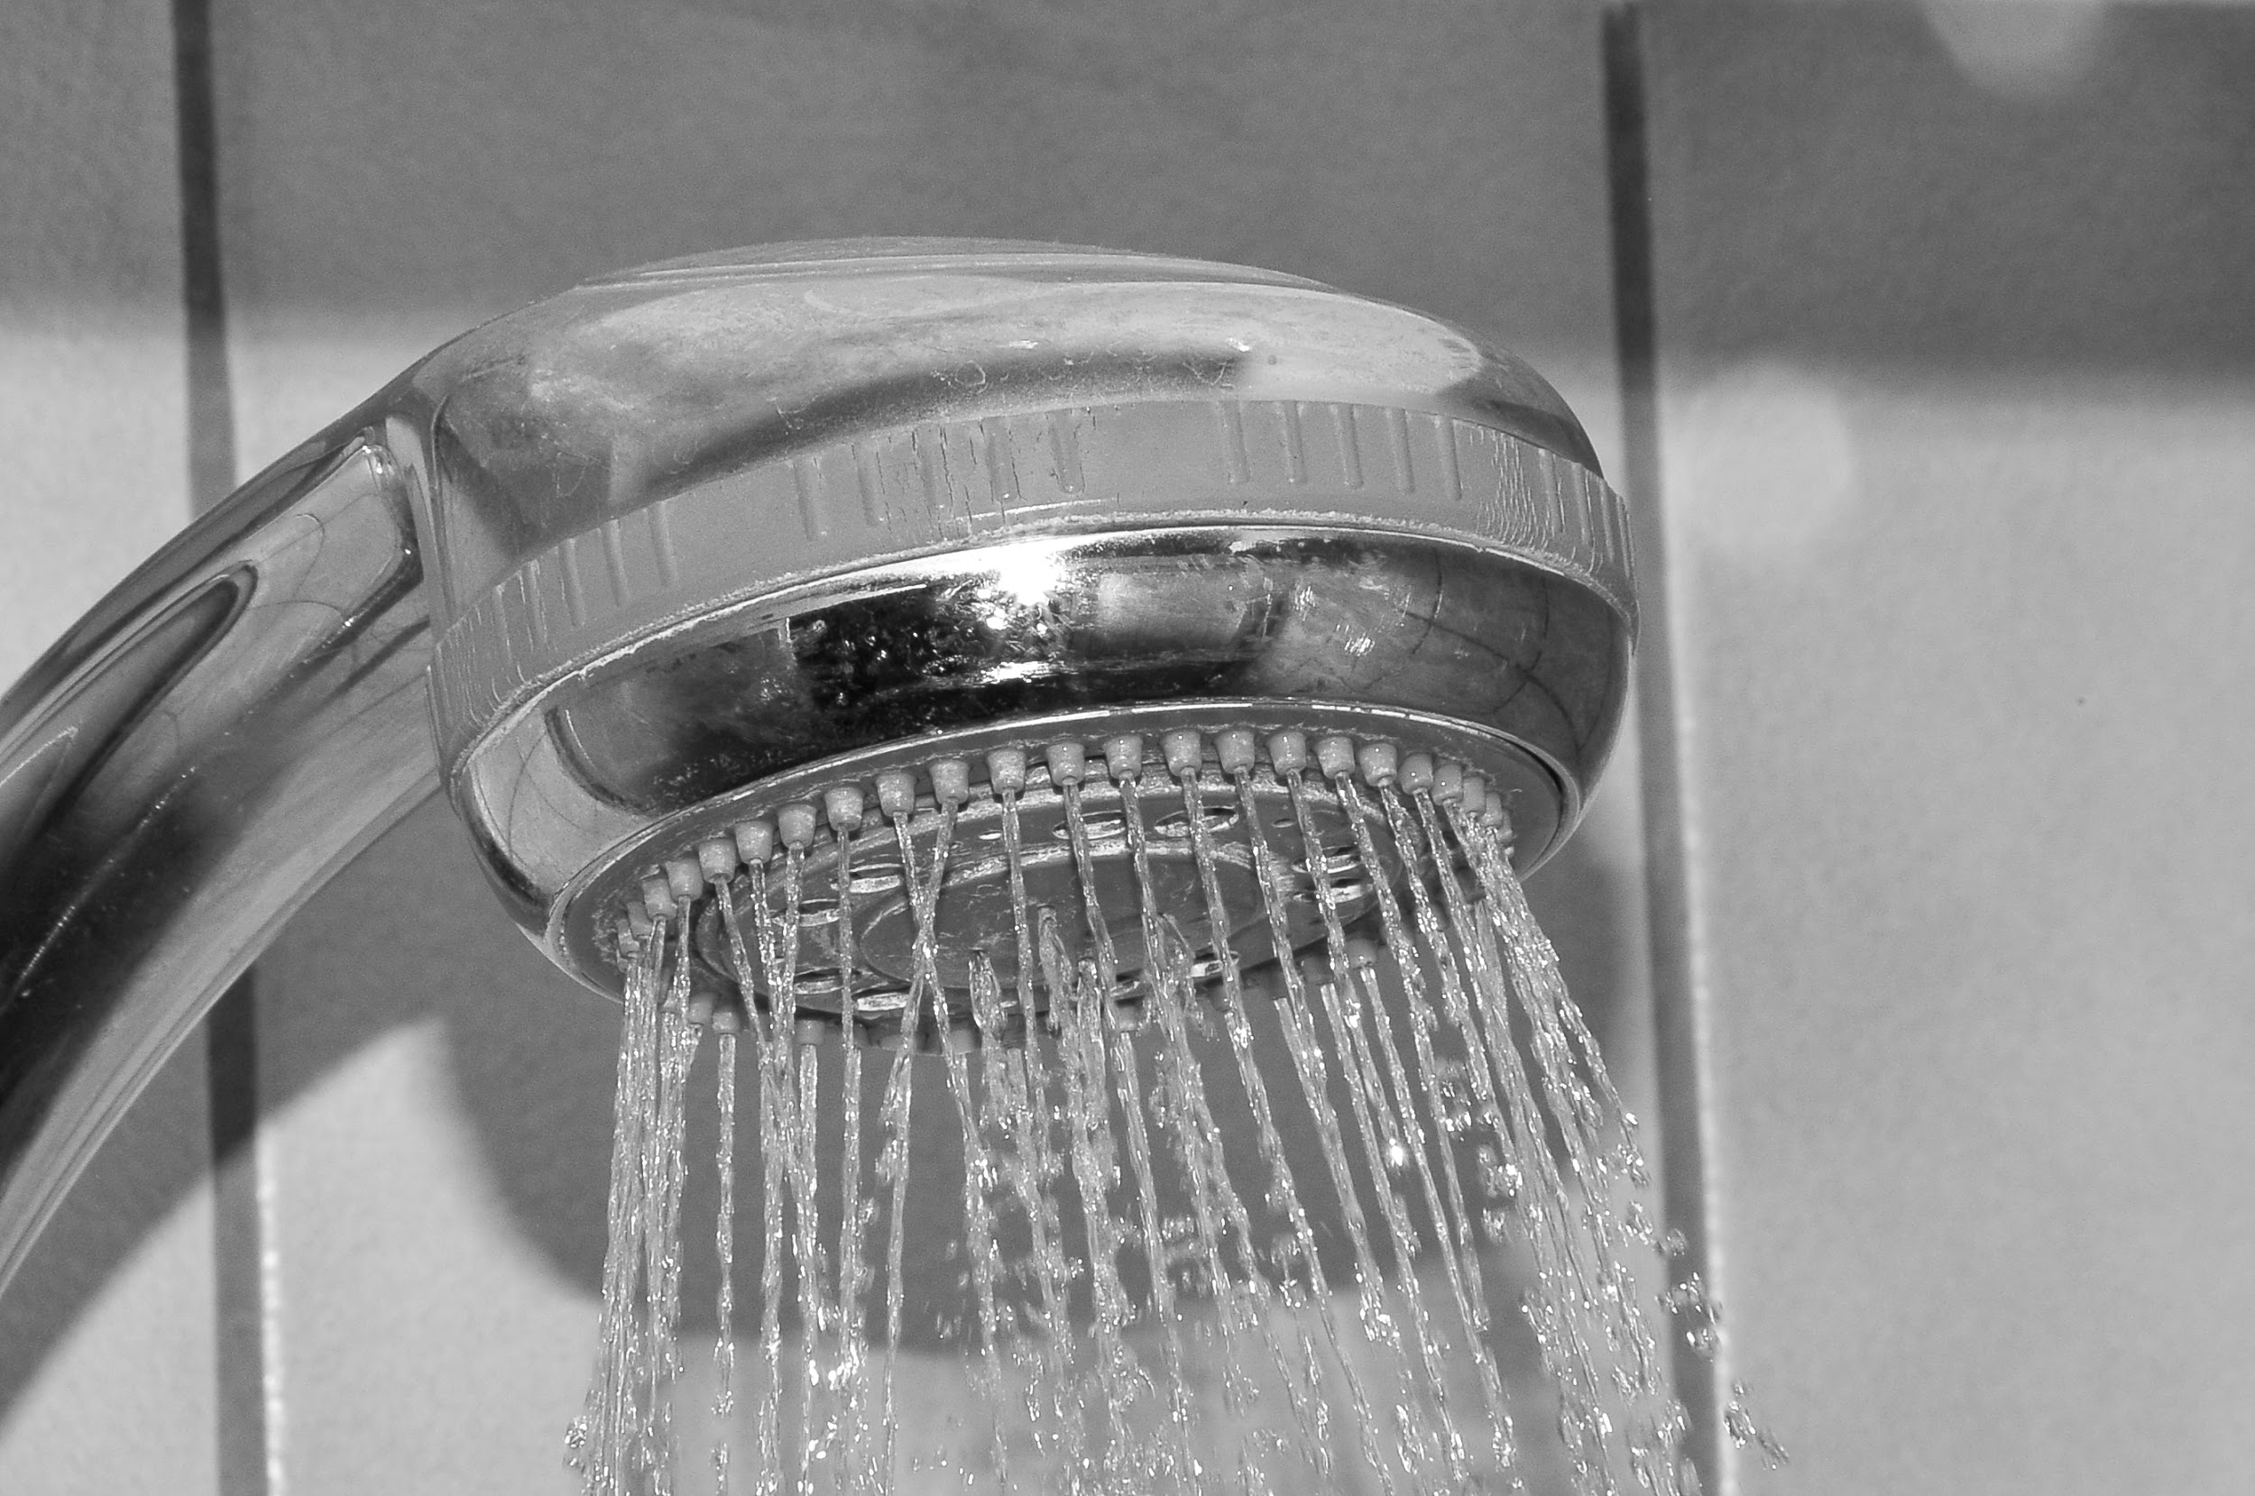

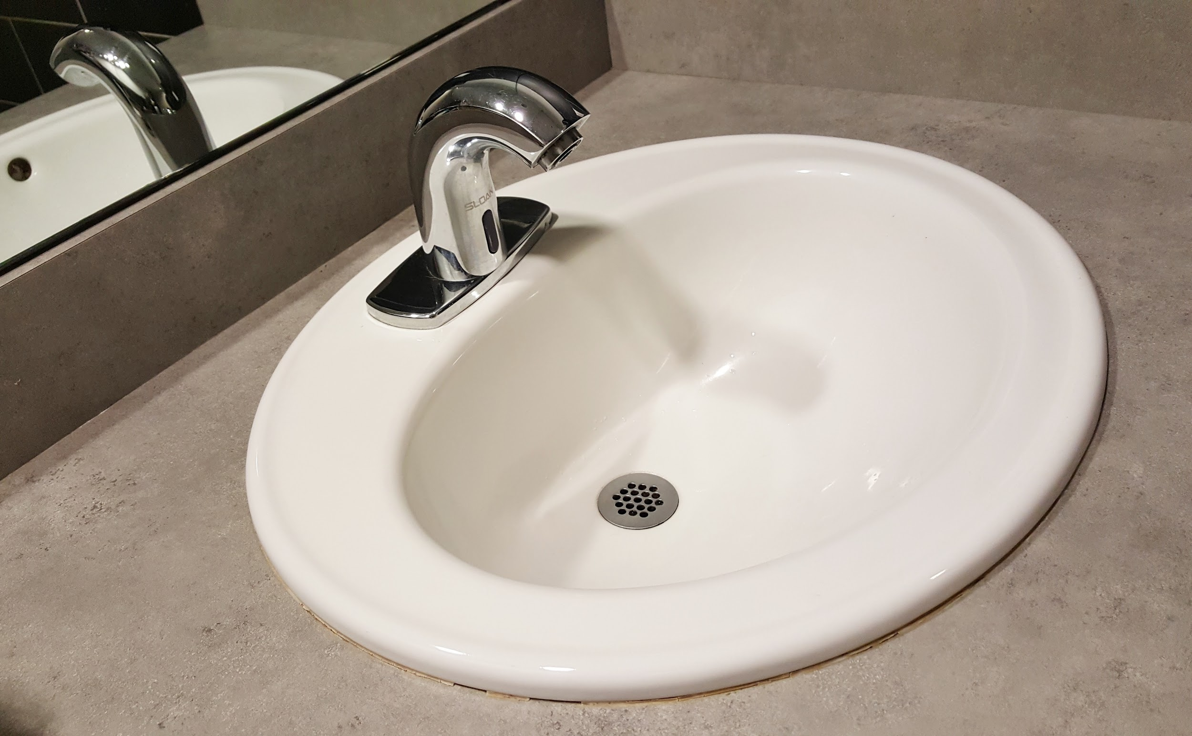
We will analyse the impacts of greywater and blackwater recycling.
You already know that renewable drinking water is 0.01% of the 70% of water that covers Earth surface.
Think of your day to day activities. How many of those activities use water? E.g. taking a shower.
Do you think these day to day activities need to use fresh water?
MAKE THE CONNECTION
Students, you already know that drinking water is 0.01% of water available.

Slide 13
We will analyse the impacts of greywater and blackwater recycling.
CHECK FOR UNDERSTANDING
What would water from toilets be classified as? Greywater Blackwater
Wastewater is water that has been used inside homes, businesses and industries.
Wastewater is classified into two categories, blackwater and greywater.
Type of water | Wastewater source | Used for
Greywater | Sinks, washing machines, and bathtubs. | Directly in home gardens provided that there are no harmful chemicals like soap and detergents in the water. Irrigation and in constructed wetlands. Washing and flushing toilets.
Blackwater | Bathrooms and toilets that contain fecal matter and urine. | Fertilizer, after recycling and treating blackwater, it must be processed and decomposed properly to destroy bacteria. Water grass and non-food plants.

Slide 14
We will analyse the impacts of greywater and blackwater recycling.
CHECK FOR UNDERSTANDING
Why does greywater and blackwater need to be kept in separate tanks?
Wastewater must be kept in separate tanks because they have different levels of contamination₁ and must be treated differently.
Wastewater can be recycled.
VOCABULARY
1- containing an unwanted substance.
Type of water | Wastewater source | Used for
Greywater | Sinks, washing machines, and bathtubs. | Directly in home gardens provided that there are no harmful chemicals like soap and detergents in the water. Irrigation and in constructed wetlands. Washing and flushing toilets.
Blackwater | Bathrooms and toilets that contain fecal matter and urine. | Fertilizer, after recycling and treating blackwater, it must be processed and decomposed properly to destroy bacteria. Water grass and non-food plants.

Slide 15
We will analyse the impacts of greywater and blackwater recycling.
Benefits of recycling wastewater: the collection, treatment and disposal of wastewater is an integral part of the water cycle that maintains the balance of water in nature.
Water conservation: Using recycled wastewater to water lawns and gardens helps to conserve₁ the fresh water that would otherwise be wasted.
Environmental benefits: Reducing the amount of sewage discharged to the ocean or rivers.
CHECK FOR UNDERSTANDING
Why do we need to conserve fresh water?
VOCABULARY
1- protect

Slide 16
We will analyse the impacts of greywater and blackwater recycling.
CHECK FOR UNDERSTANDING
Why do you think people would be concerned about recycling blackwater?
There are positives and negatives to recycling wastewater.
Type of wastewater | Pros | Cons
Greywater | Conserve water. Used for watering all plants. Usually contains detergents that have plant nutrients. | Lengthy treatment process. If mistreated can cause illness.
Blackwater | Conserve water. Nutrient rich for plants to feed off, no need for fertilizer. | Needs to be treated at a certain heat. Can’t be used for watering plants for eating If mistreated can cause illness.

Slide 17
We will analyse the impacts of greywater and blackwater recycling.
Complete the following table in your workbook by using the list provided.
PROS AND CONS LIST
Conserve water. If mistreated can cause illness. Used for watering all plants. Can’t be used for watering plants for eating Usually contains detergents that have plant nutrients. Needs to be treated at a certain heat.
Type of wastewater | Pros | Cons
Greywater |  | Lengthy treatment process. If mistreated can cause illness.
Blackwater | Conserve water. Nutrient rich for plants to feed off, no need for fertilizer.

Slide 18
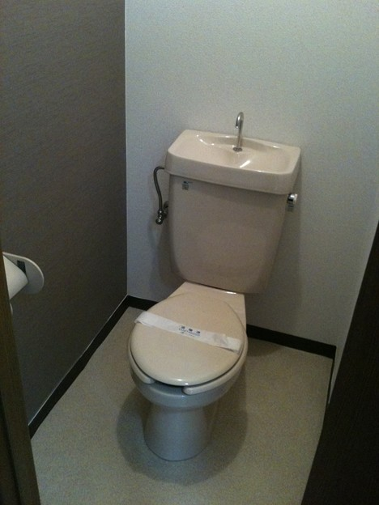
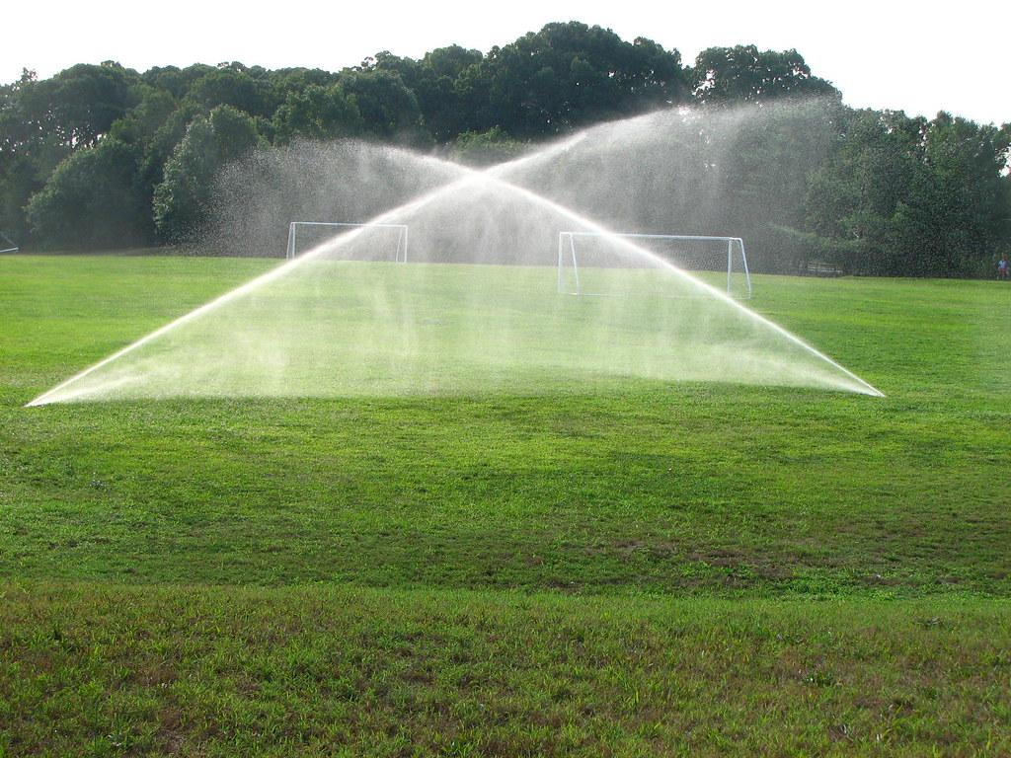
We will analyse the impacts of greywater and blackwater recycling.
CHECK FOR UNDERSTANDING
Where does greywater come from?
In times of drought, recycled greywater is very useful. The flow of greywater from washing dishes or clothes can even be used to heat water for bathing, reducing energy use.

Slide 19
We will analyse the impacts of greywater and blackwater recycling.
CHECK FOR UNDERSTANDING
What is the difference between greywater and blackwater?
Wastewater is used water that has been used inside homes, businesses and industries. Wastewater can be recycled and used for watering plants and cleaning. By using recycled water we are conserving fresh water.
Type of water | Wastewater from | Used for
Greywater | Sinks, washing machines, and bathtubs. | Directly in home gardens provided that there are no harmful chemicals like soap and detergents in the water. Irrigation and in constructed wetlands. Washing and flushing toilets.
Blackwater | Bathrooms and toilets that contain fecal matter and urine. | Fertilizer, after recycling and treating blackwater, it must be processed and decomposed properly to destroy bacteria. Water grass and non food plants.

Slide 20
We will analyse the impacts of greywater and blackwater recycling.
HINT
Students, remember…. Greywater comes from baths, showers, sinks, washing machines, dishwashers. Blackwater comes from water that contains fecal matter.
Using the pro and con table to answer the following questions in your workbook.
What are the benefits of greywater recycling?
Based on the pros and cons table, form an argument for or against blackwater recycling.
Notes:
Please include tasks/questions here rather than just referring to a worksheet. This will save on photocopying and facilitate sharing with other schools.
Try and build tasks/questions which escalate through Bloom’s Taxonomy. This will help with differentiation.

Slide 21
We will analyse the impacts of greywater and blackwater recycling.
We will define greywater.
We will define blackwater.
We will discuss the benefits of recycling water.
We will debate greywater and blackwater recycling using scientific evidence.
CHECK FOR UNDERSTANDING
Check Success Criteria.

Slide 22
We will analyse the impacts of greywater and blackwater recycling.
CHECK FOR UNDERSTANDING
Benefits of recycling wastewater:
Financial savings: Reducing water bills by switching garden irrigation from scheme to greywater.
Environmental benefits: Reducing the amount of sewage discharged to the ocean or rivers. Plants that are grown using recycled blackwater do not need fertilizer because the water is already nutrient rich and the plants feed off of them, this eliminates the need for polluting the environment with fertilizing chemicals.
Water conservation: Using recycled blackwater to water lawns and non-food gardens helps to conserve the fresh water that would otherwise be wasted. Watering gardens during a sprinkler ban.
Habitat protection: Recycling blackwater lessens the chance of the wastewater seeping into natural habitats.
VOCABULARY
1-

